Slide 1
Density Functional Theory
Structure, electronic and magnetic properties of materials
Summary
Magnetic
Structure
Electronic
Junfei Ding

Slide 2
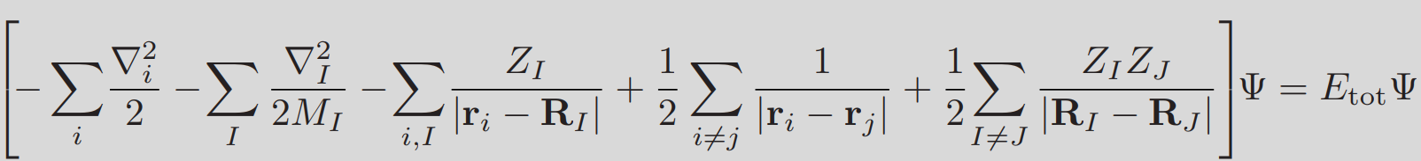

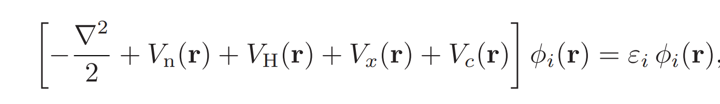
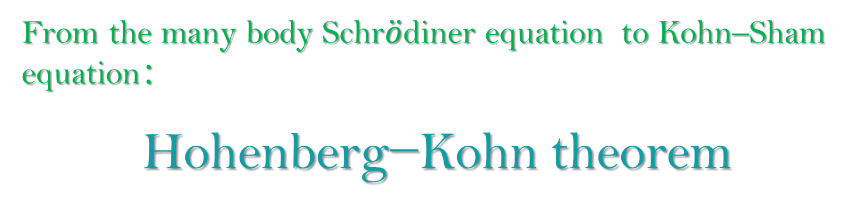
Density Functional Theory
From the many body Schr$\ddot{o}$diner equation to Kohn–Sham equation：
Hohenberg−Kohn theorem
Summary
Magnetic
Structure
Electronic
Junfei Ding 14-Sep-2020

Slide 3

Hartree–Fock equations
$$\left[−\frac{∇^{2}}{2}+V_{n}\left(r\right)+V_{H}\left(r\right)\right]φ_{i}(r)+∫dr^{′}V_{X}\left(r,r^{′}\right)φ_{i}\left(r^{′}\right)=ε_{i}φ_{i}(r)$$
$$n(r)=\sum_{i}{ }{\left|φ_{i}\left(r\right)\right|}^{2}$$
$$∇^{2}V_{H}\left(r\right)=−4πn\left(r\right)$$
$$V_{X}\left(r,r^{′}\right)=−\sum_{j}{ }\frac{φ_{j}^{∗}\left(r^{′}\right)φ_{j}\left(r\right)}{\left|r−r^{′}\right|}$$
(For $V_{X}$ the sum runs over the occupied single-particle states, and is non-local in the sense that its evaluation involves an integration over the additional variable ${\text{r}}^{′}$ )
Summary
Magnetic
Structure
Electronic

Slide 4
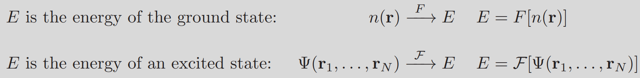
Hohenberg−Kohn theorem
The core concept of density functional theory is the observation that, if E is the lowest possible energy of the system, i.e. the energy of the ground state, then E is a functional of the electron density only:
E = F[n]
Summary
Magnetic
Structure
Electronic

Slide 5

Hohenberg−Kohn theorem
Hoenberg–Kohn theorem (Inhomogeneous electron gas. Physical Review,136, B864.)
1) In the ground state the electron density determines uniquely the external potential of the nuclei, $V_{n}$,: n → $V_{n}$.
2) In any quantum state the external potential, $V_{n}$ , determines uniquely the many electron wavefunction: $V_{n}$ → Ψ.
3) In any quantum state the total energy, E, is a functional of the many-body
wavefunction : Ψ → E.
By combining these premises we infer that, in the ground state, the density determines uniquely the total energy: n → $V_{n}$ → Ψ → E. This indicates that the total energy must be a functional of the density: E = F[n]
Summary
Magnetic
Structure
Electronic

Slide 6
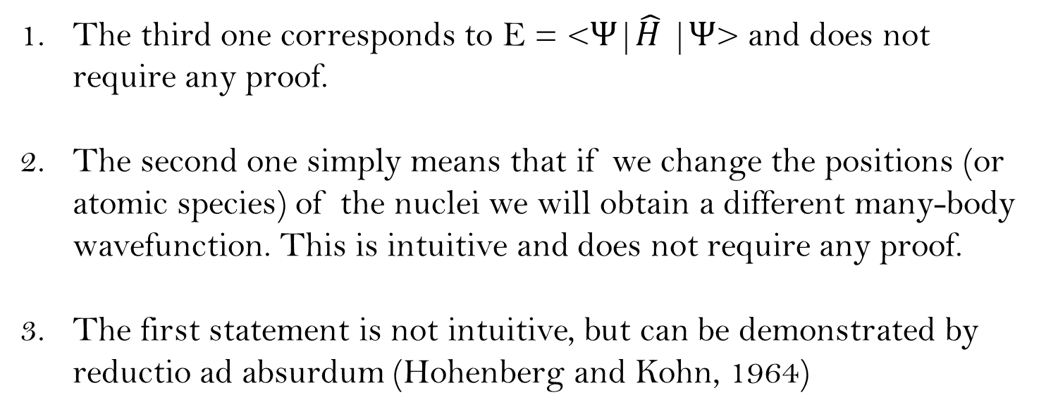
Hohenberg−Kohn theorem
The third one corresponds to E = <Ψ|$\hat{H}$ |Ψ> and does not require any proof.
The second one simply means that if we change the positions (or atomic species) of the nuclei we will obtain a different many-body wavefunction. This is intuitive and does not require any proof.
The first statement is not intuitive, but can be demonstrated by reductio ad absurdum (Hohenberg and Kohn, 1964)
Summary
Magnetic
Structure
Electronic

Slide 7
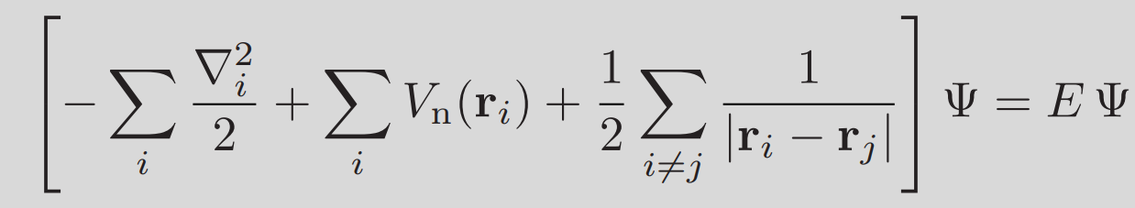
Clamped nuclei approximation
0($M_{I}=∞)$
Constant
Summary
Magnetic
Structure
Electronic
This is the fundamental equation of electronic structure theory.

Slide 8
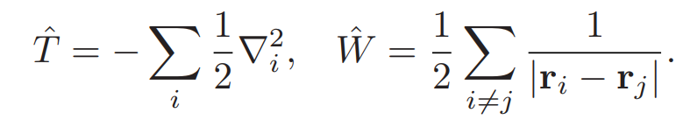
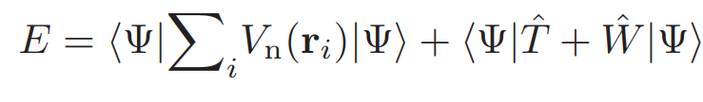
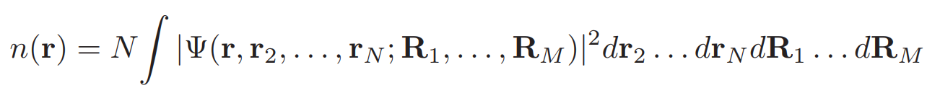
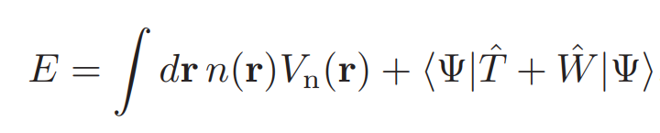

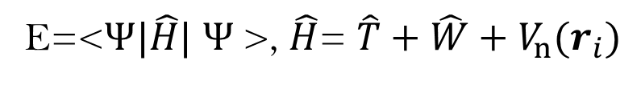
Hohenberg−Kohn theorem
The idea is to start from the assumption that the same ground-state electron density can be obtained from two different external potentials, and show that this leads to a contradiction
E=<$Ψ|\hat{H}|$ $Ψ$>, $\hat{H}$= $\hat{T}+$ $\hat{W}+V_{n}(r_{i})$
Summary
Magnetic
Structure
Electronic

Slide 9
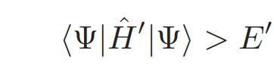

Hohenberg−Kohn theorem
Now let us assume that Ψ is the ground-state wavefunction for the potential $V_{n}$, with energy E and density n.
Suppose there exists another potential, $V_{n}^{′}≠V_{n}$, which generates the same density n, and let us call $H^{′}, Ψ^{′} and E^{′}$ the Hamiltonian, the ground-state wavefunction and the ground-state energy corresponding to this new potential, respectively.
Since Ψ is not the ground state of $V_{n}^{′}$ we can write:
Summary
Magnetic
Structure
Electronic

Slide 10
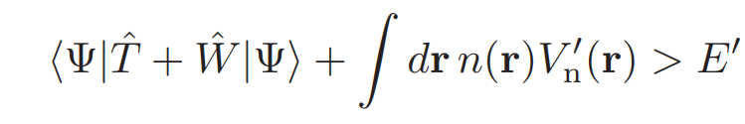
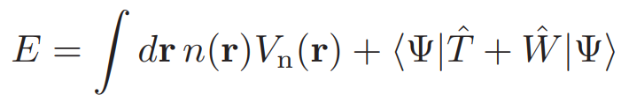
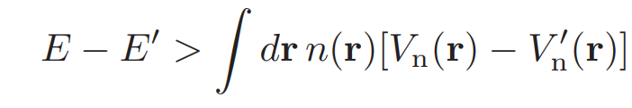
Hohenberg−Kohn theorem
Summary
Magnetic
Structure
Electronic

Slide 11
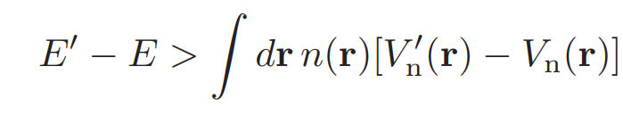
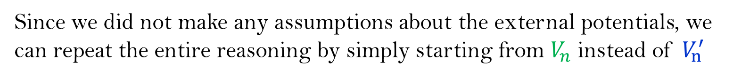
Hohenberg−Kohn theorem
Since we did not make any assumptions about the external potentials, we can repeat the entire reasoning by simply starting from $V_{n}$ instead of $V_{n}^{′}$
Summary
Magnetic
Structure
Electronic
As a last step we can add up the last two equations, obtaining 0 > 0. This is obviously a contradiction.
This demonstrates the first step of the Hohenberg–Kohn theorem and completes the proof.

